Slide 1

FLIGHT PRICE PREDICTION
Submitted by: Haindavi Chakravarthi
Internship : 23

Slide 2
Table of contents:
Introduction
Analytical Problem Framing
Data Analysis
Pre-processing
Visualizations
Building the models
Conclusion
Limitations and Scope for Future Work

Slide 3
INTRODUCTION:
Anyone who has booked a flight ticket knows how unexpectedly the prices vary. The cheapest available ticket on a given flight gets more and less expensive over time. This usually happens as an attempt to maximize revenue based on –
Time of purchase patterns (making sure last-minute purchases are expensive)
Keeping the flight as full as they want it (raising prices on a flight which is filling up in order to reduce sales and hold back inventory for those expensive last-minute expensive purchases)
So, you have to work on a project where you collect data of flight fares with other features and work to make a model to predict fares of flights.

Slide 4
ANALYTICAL PROBLEM FRAMING:
In this analysis, we will be predicting the flight price for various class in domestic flights
Using this as a base, I have collected the data from few websites. The data was collected the period of two weeks. I have included various features like flight class, duration, number of stops between destination and so on
Once the data is collected, we will extract features from it, the data will be cleaned and pre-processed with all the necessary tools and the same will be used to build machine learning models in order to predict the price of the same

Slide 5
DATA ANALYSIS:
The dataset has 1746 rows and 9 columns. Using this dataset we will be training the Machine Learning models on 70% of the data and the models will be tested on 30% data.
There are no missing values in the dataset. However, we can expect outliers and un-realistic values for certain variables
I’m extracting features like day of week, sessions in a day (i.e., morning, afternoon, night and so on), month, day, departure hour, departure minute and total duration in minutes.

Slide 6
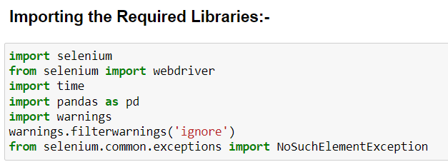
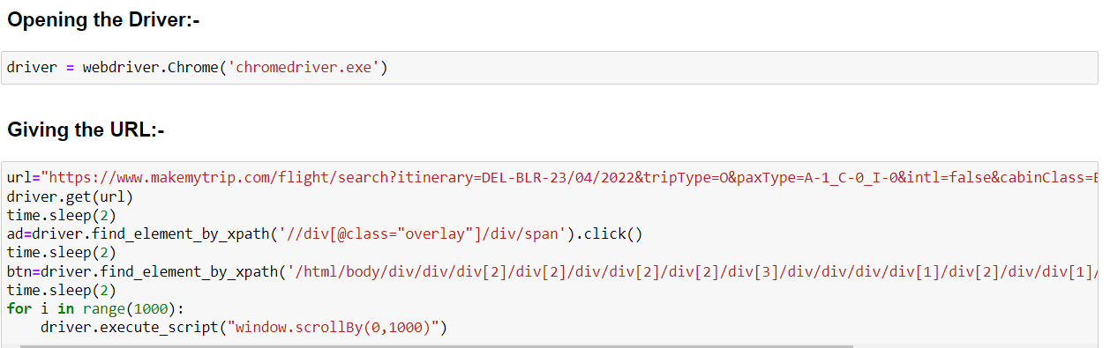
Data Sources and their formats:
The data is scrapped from the website “yatra.com” and we have scrapped around 1746 records and 9 columns in the form of different dataframes, which are concatenated and formed into a new dataframe which is our final dataset which is used further for modelling.
Scrapping of the Data: -
Here we have imported the necessary libraries for scrapping the data and we have opened the driver and given the url and got the page for scrapping and also we have given the x-path and also selected for a particular range.

Slide 7
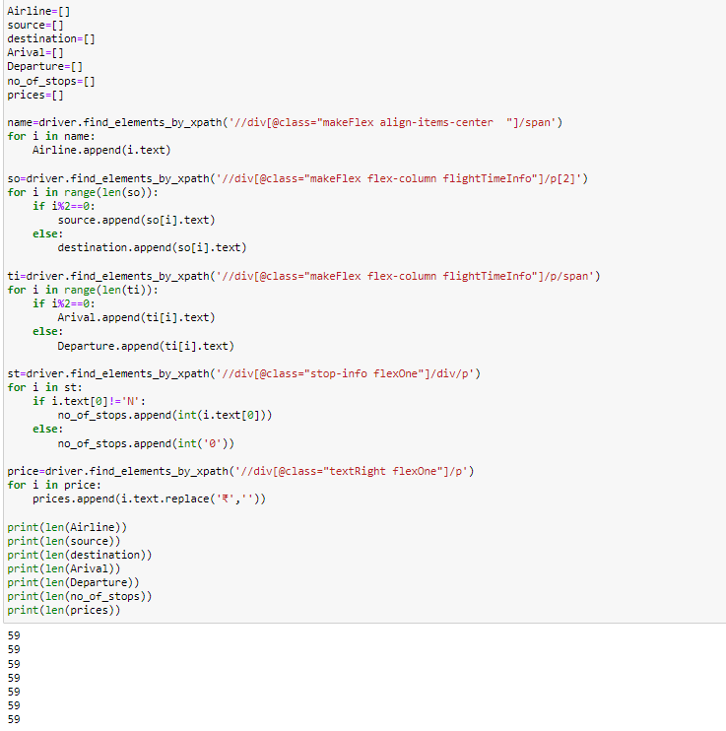
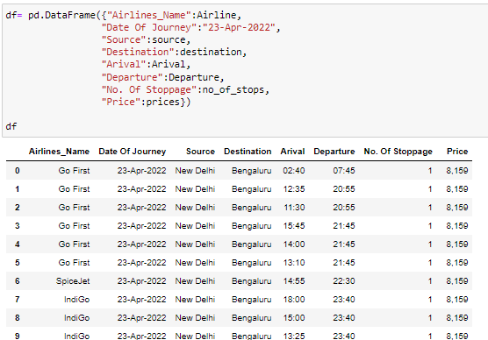
This code which I have used by changing the attributes like date and locations of journey and made a dataframe which is sufficient for our model building.
Here we have taken the x-path and scrapped the data and now we will covert the data into a dataframe for our model building.

Slide 8
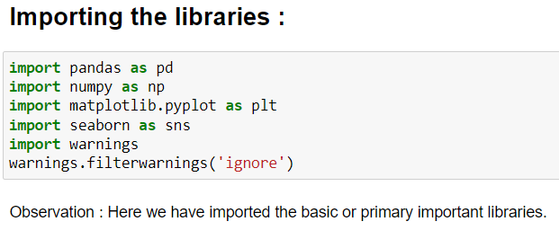
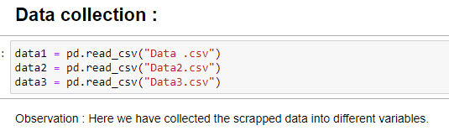
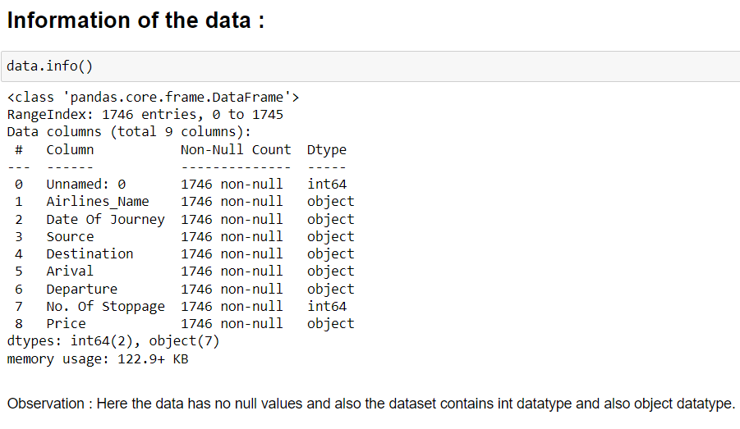
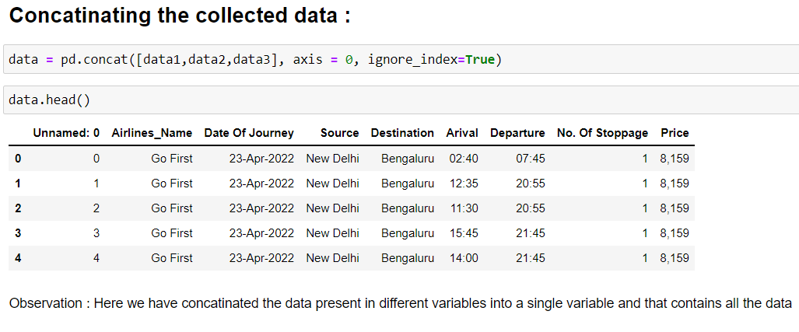
Now we will continue with our model building:
Here we have imported the basic libraries and have collected the data in different variables and concatenated the data into a single variable and then checked the basic information of the data like “null values” and “datatype” of the variables of the data.

Slide 9
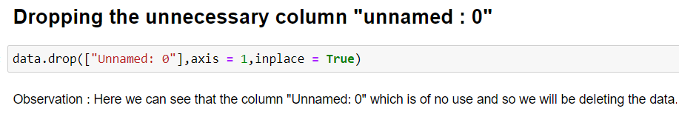
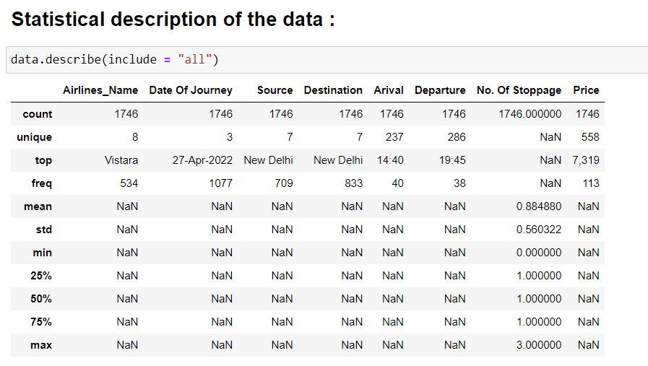
Here we can see that the statistical description of both of the numerical or object columns have:
1) The column "No, of stoppage" which has std<mean and the "min" value is 0 and the "max" value is 3 and the 25%,50%,75% quartiles are all same and have the value "1.0" Here we can see that the statistical description of the object columns have
2) The columns have no nulls, the column with high frequency is "Date of journey" and column with least frequency is "Departure" and the "Airline Vistara" is with high count among all the others.

Slide 10
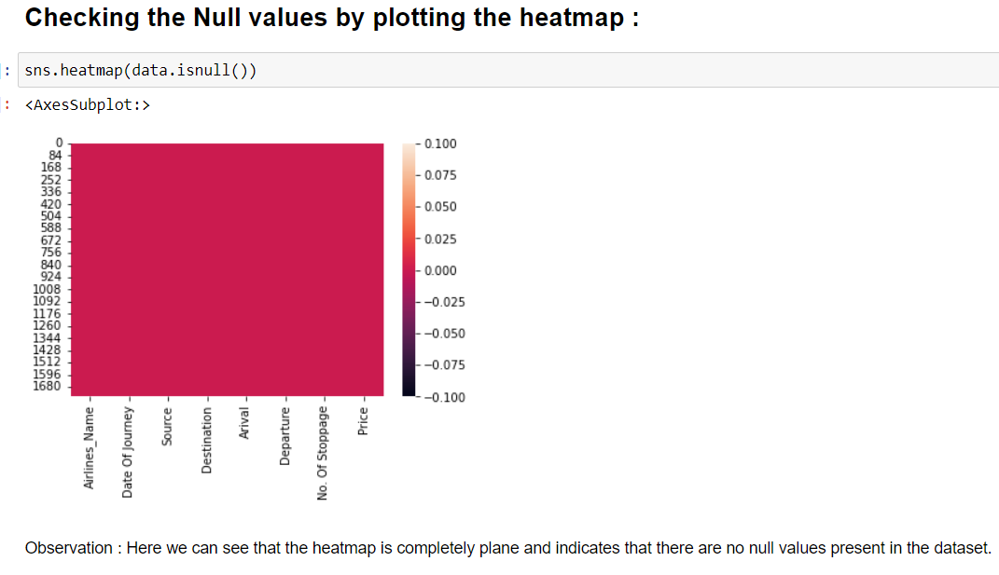
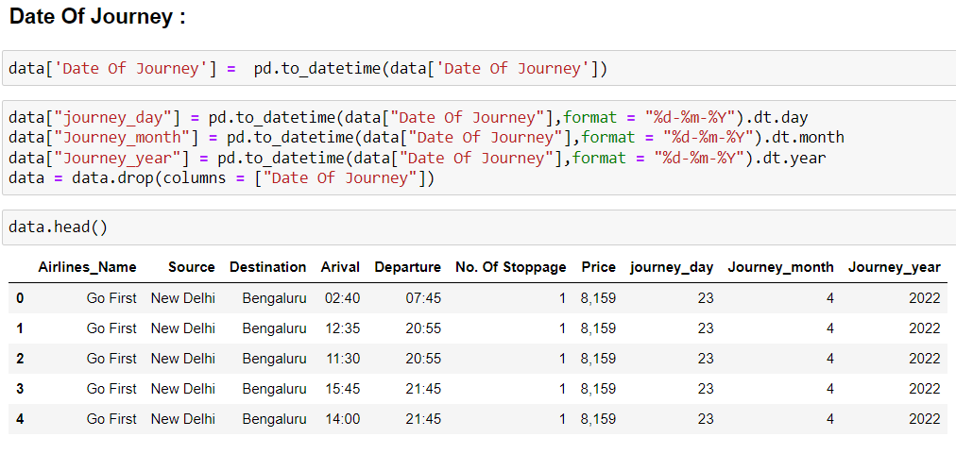

Here we can see that we have splitted the column "Date of journey" into multiple columns and replaced the columns names as "journey_day","Journey_month","Journey_year" and finally we will be dropping the parent column "Date of Journey".
Here we have seen that the "journey_year" is same in all the records and so we can drop the column as of now.
Data Pre-processing Done:

Slide 11
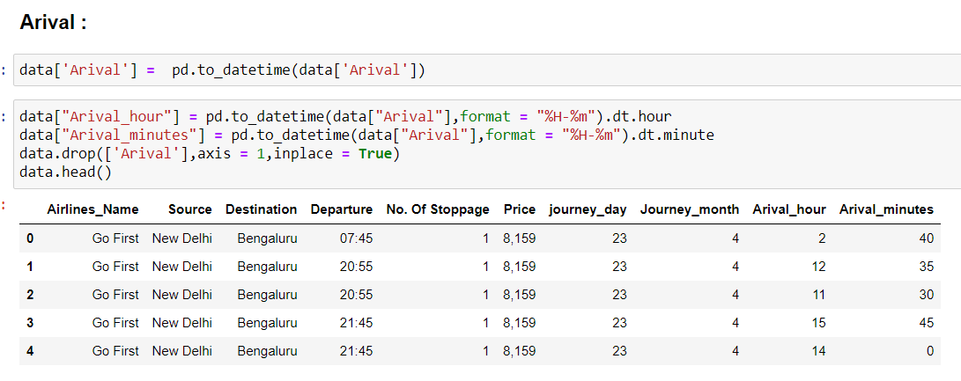
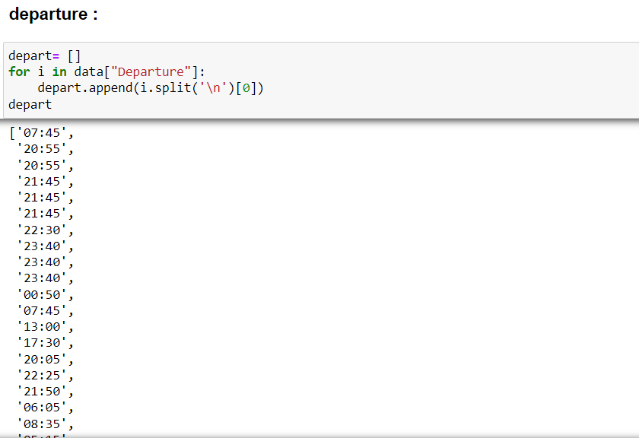
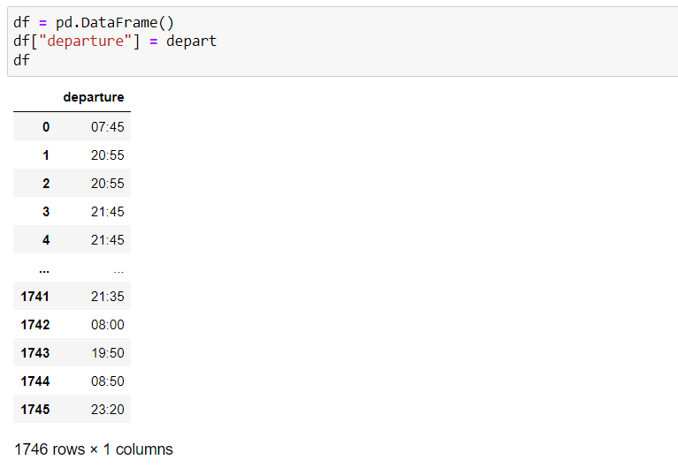
Here we can see that we have splitted the column "Arival" into multiple columns and replaced the columns names as "Arival_hour","Arival_minutes" and finally we will be dropping the parent column "Arival".
Here we can see that we have created an empty list and splitted the data of the column "departure" and appended that into an empty list and converted that into a dataframe

Slide 12
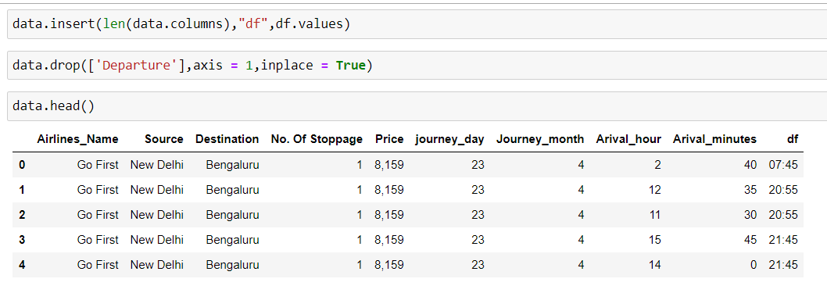
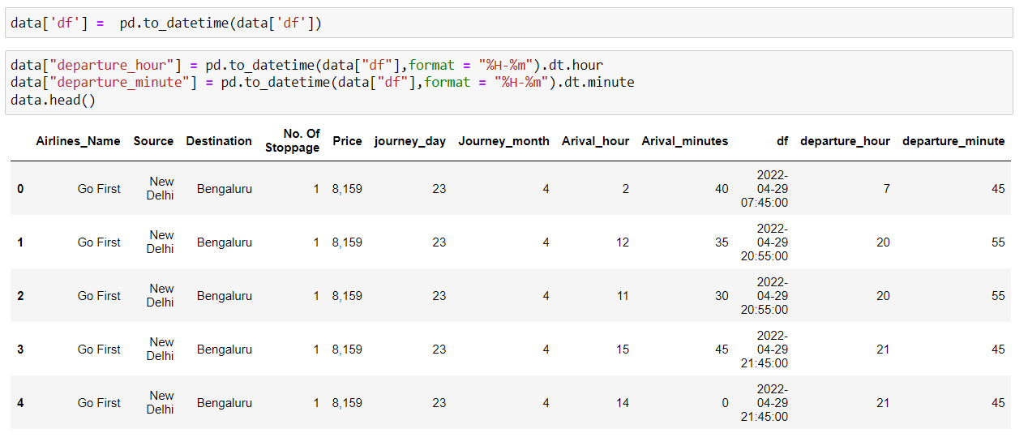
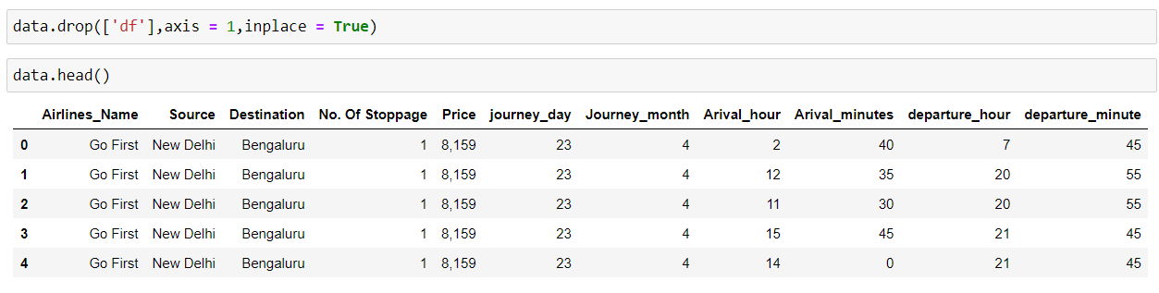
Here we have inserted this dataframe into our dataset and then dropped the parent column "Departure" as this column is converted into the dataframe "df" we will use it further for our pre-processing.
Here we can see that the column converted into dataframe as "df" is now further splitted into more columns "departure_hour" and "departure_minute".
Here we can see that as we have dropped the column "df" now.

Slide 13
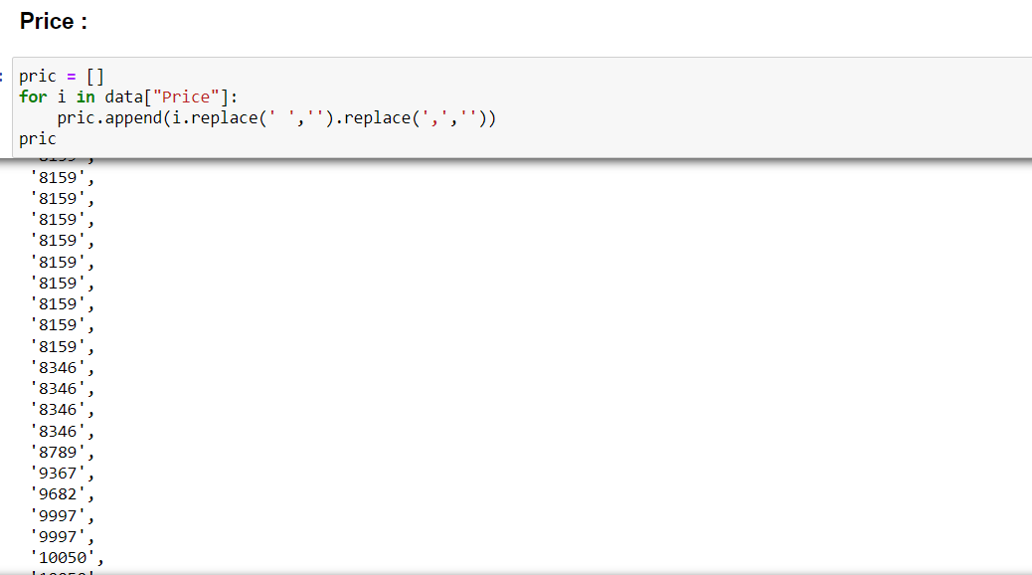
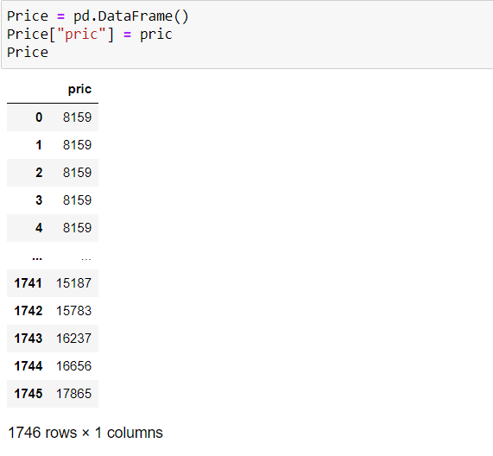
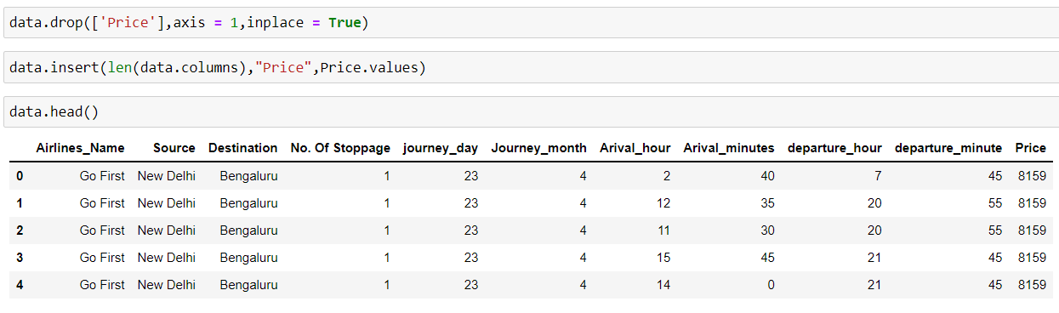
Here we can see that we have created an empty list and splitted the data present in the column and then appended the data into the list and converted that into the dataframe.
Here we can see that we have deleted the parent column "Price" as we have created a dataframe and we have inserted the dataframe "Price" into the dataset.

Slide 14
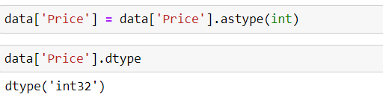
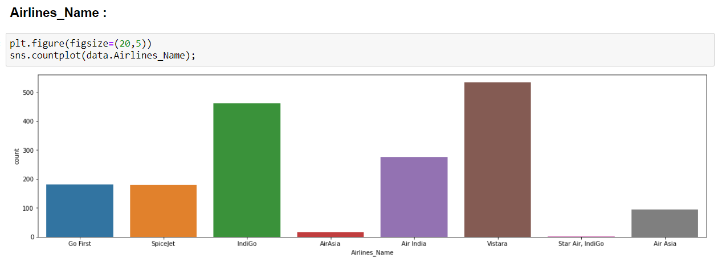
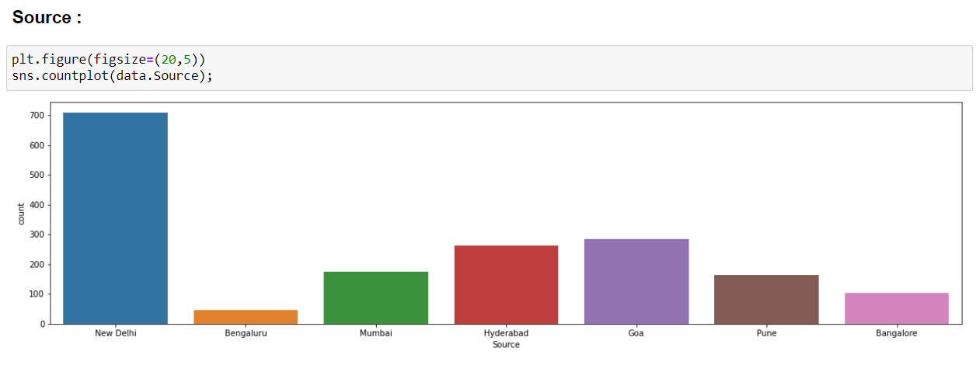
Here we can see that we have converted the datatype into "int" type.
Visualizations:
Here we will have a look at the visualizations of few of the columns.
Univariate Analysis:
Here we can see that the highest count is for the attribute "Vistara" followed by "Indigo" and the least count is for the attribute "AirAsia".
Here we can see that the highest count is for "New Delhi" followed by "Goa" next by "Hyderabad Source" and least count is for the category "Bengaluru"

Slide 15
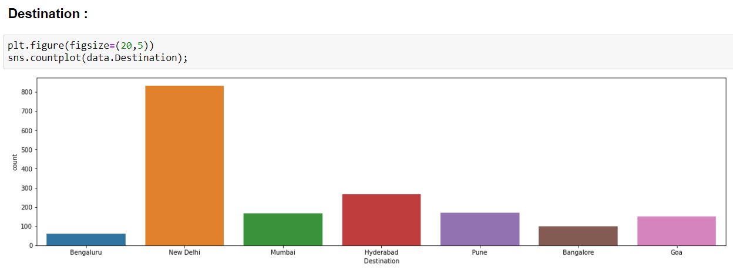
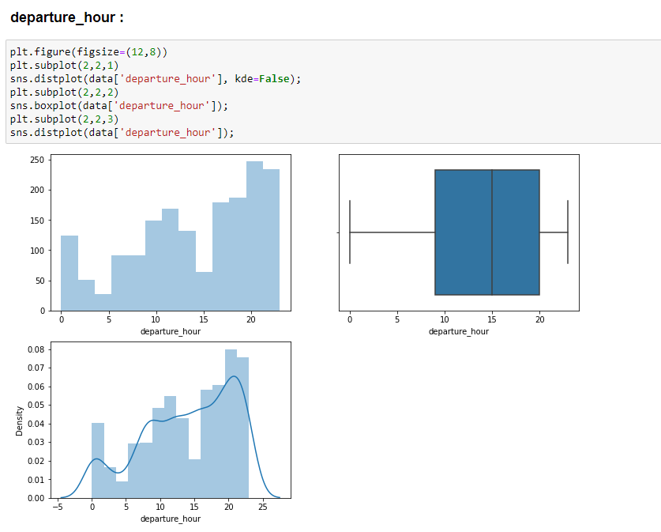
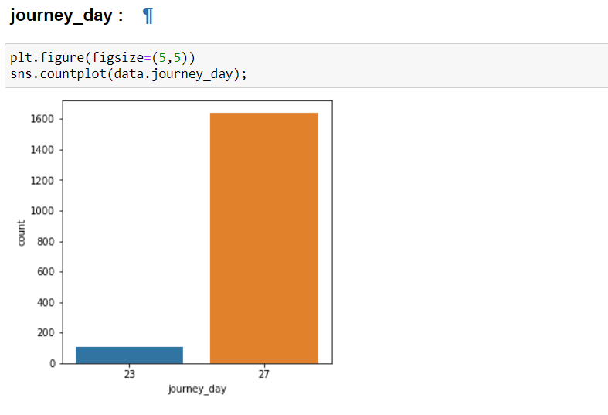
Here we can see that the highest count is for the category "New Delhi" followed by "Hyderabad Destination" and the least count is for the column "Bengaluru"
Here we can see that there are no outliers in the boxplot and the distribution curve is not normal and instead it is skewed somewhat
Here we can see that the highest count is for the category "27th journey_day" and least is for "23rd journey_day"

Slide 16
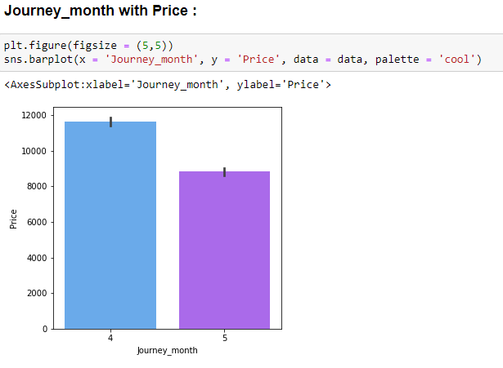
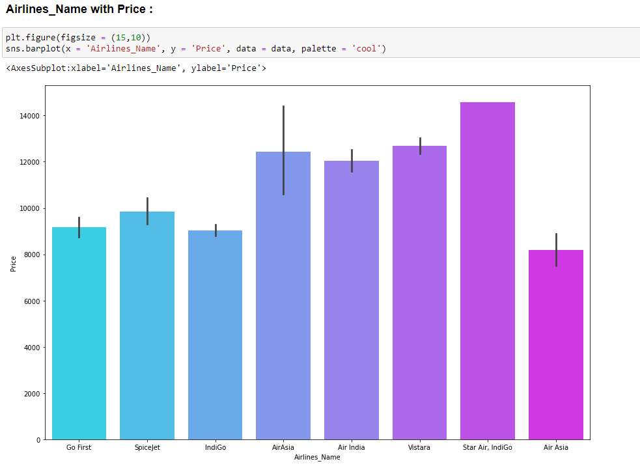
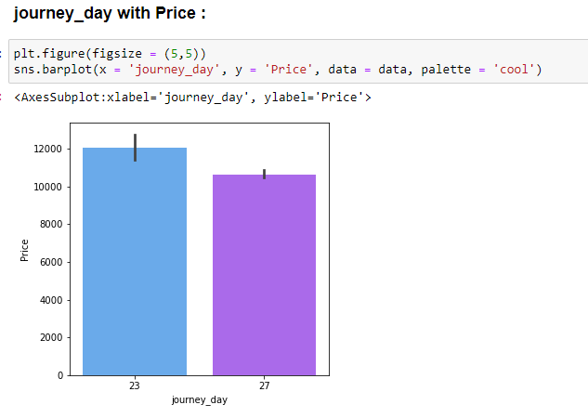
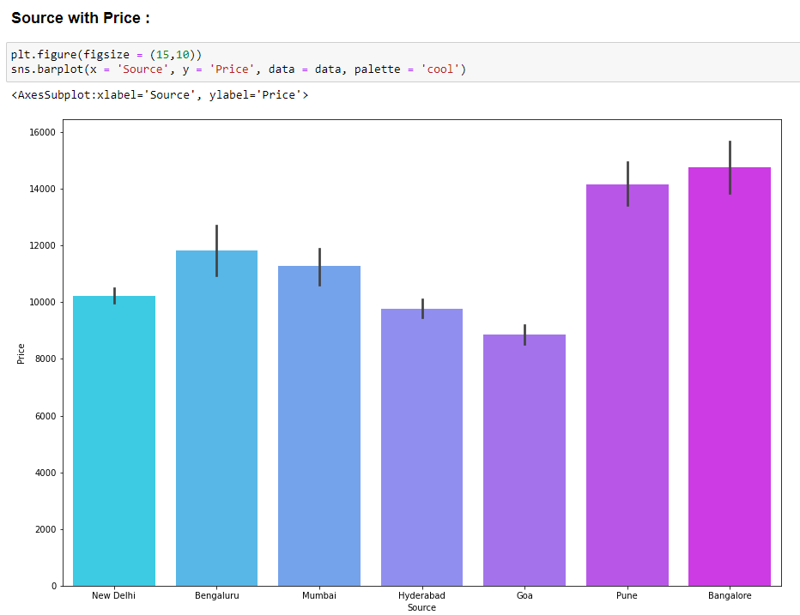
Bivariate Analysis:
Here we can see that the high price is for the 4th journey month than the other months
The price range of the airlines generally starts from 8000 and extends till 14000 and the highest price is for the airlines "Star Air, Indigo" and the least price is for "Air Asia".
Here we can see that the price range for 23rd journey day is high when compared to 27th journey day.
Here we can see that the highest price range is for the "Bangalore" Airlines followed by "Pune" and the least is for "Goa" Airlines.

Slide 17
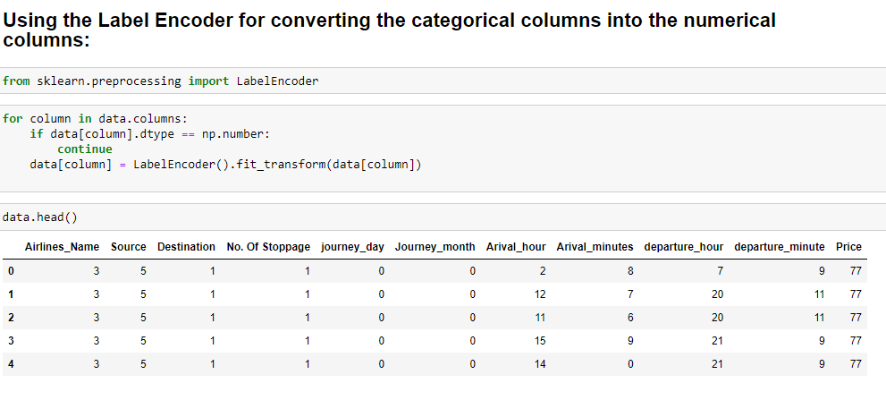
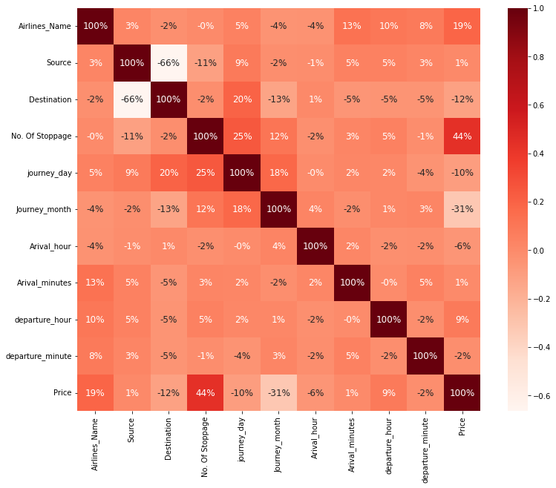
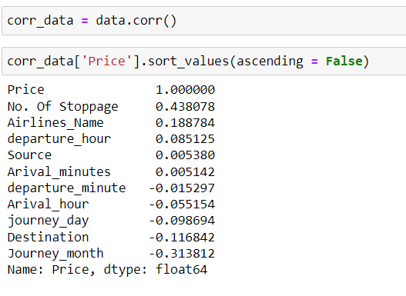
Here we have encoded the categorical columns into numerical columns and later proceed with correlation.
Correlation:
Here we can see that the variables are with less correlation with the label column and also less than 50% and the variable columns which are with high correlation among the other are "Source" and "Destination" Columns with 44% of correlation and the variable column which is with high correlation among the other variables with the label column is "No. of Stoppage" with the 44% of correlation and the high negative correlation with the label columns compared to the other columns is "Journey_month" which is with -31%
Here we can see that all the values of the columns are within the range from -0.5 to 0.5 and so there is bad correlations of the variables with the label column

Slide 18
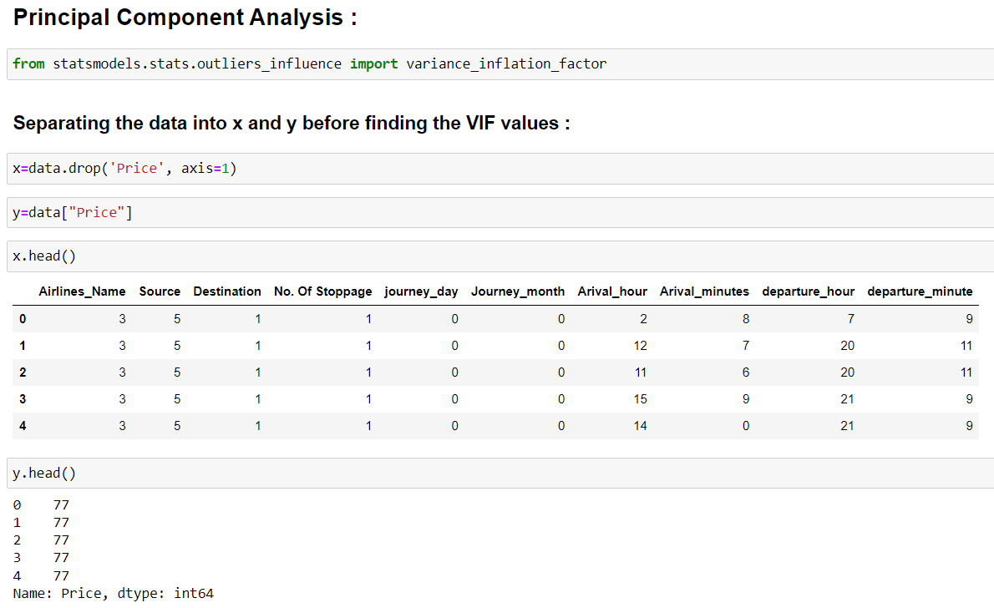
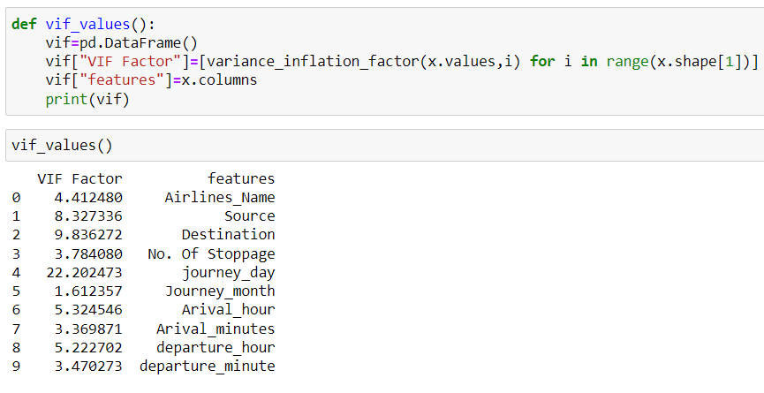
Here we are using "PCA" to check the "multicollinearity" issue among the variables and before that we have separated the dataset in between 2 variables "x" and "y" in which "x" contains all the data except the label column and "y" contains the label column and we have checked the VIF values for "x" and the highest VIF value is for "Journey_day" and the least "VIF" value is for "Journey_month"

Slide 19
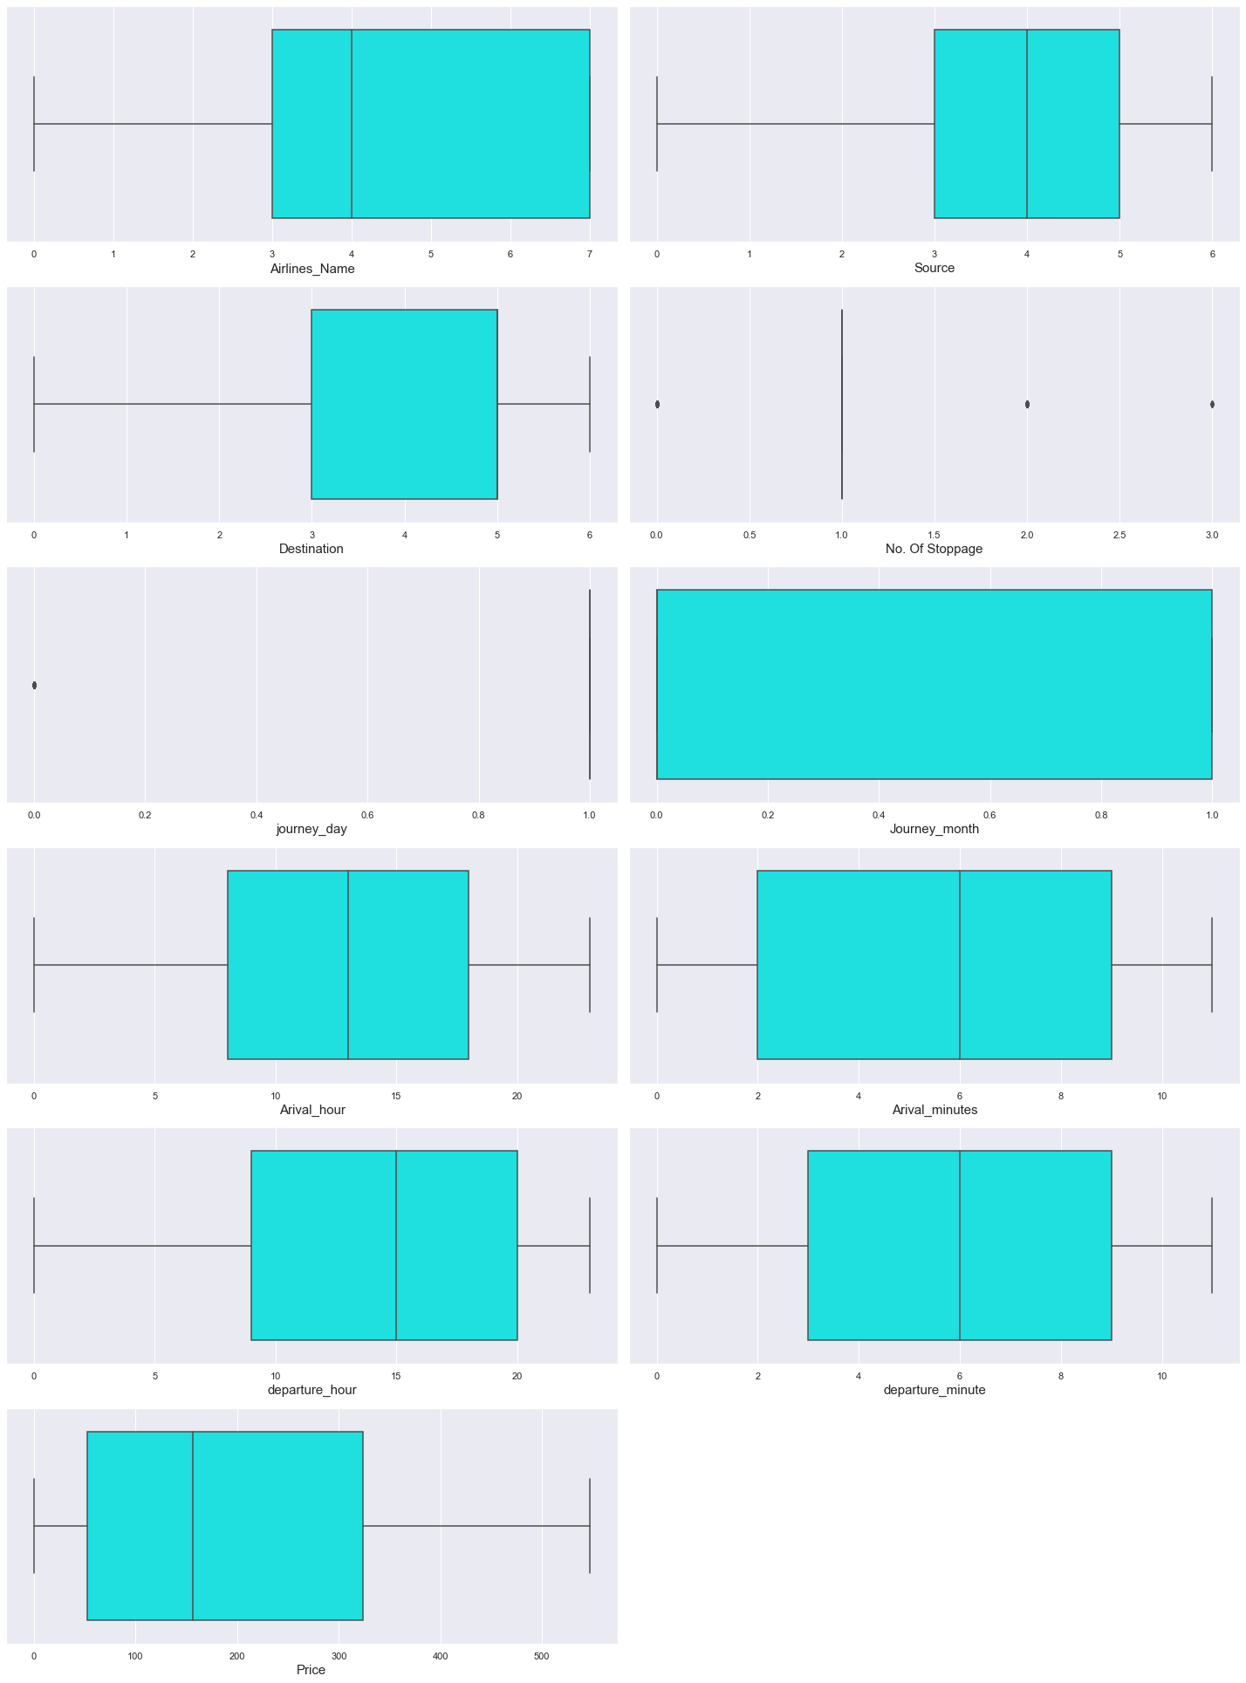
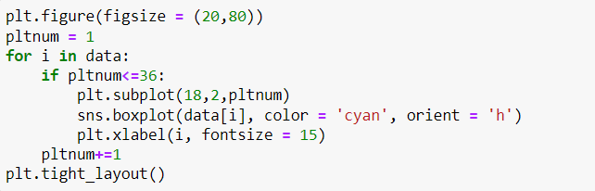
Detection of outliers:
Here we can see that there are not many outliers in most of the columns and there are columns with few outliers and are negligible

Slide 20
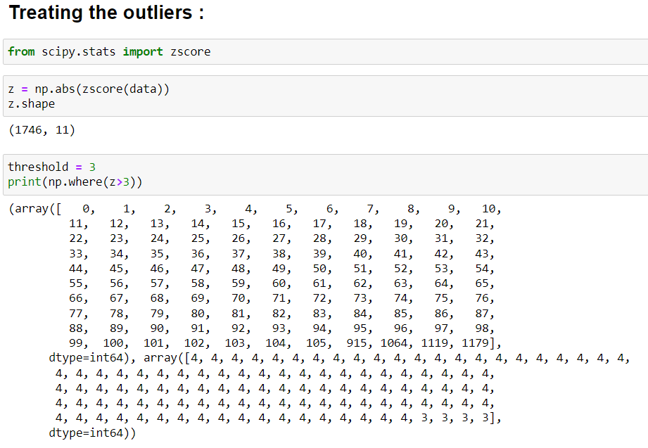
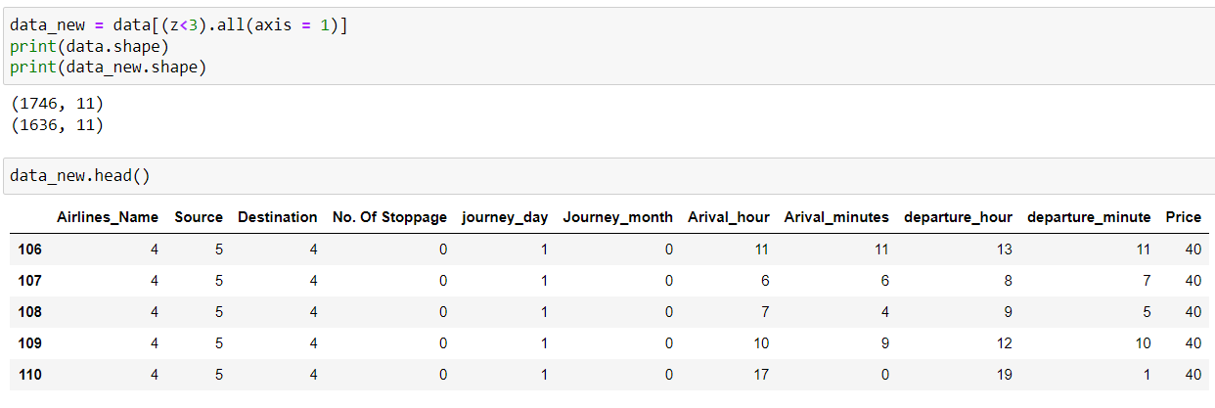
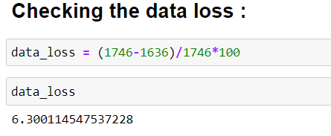
Here we can see that for treating the outliers we use "Z-Score" method and for that we need a threshold value which we have taken as 3 and after treating the outliers the number of records is 1636 which have decreased from 1746 and so we can believe that we have successfully treated few among the outliers and so we can proceed with our model building
Here we can see that the number of records decreased to 1636 and the data loss% is 6.3% and is negligible and so we can proceed

Slide 21
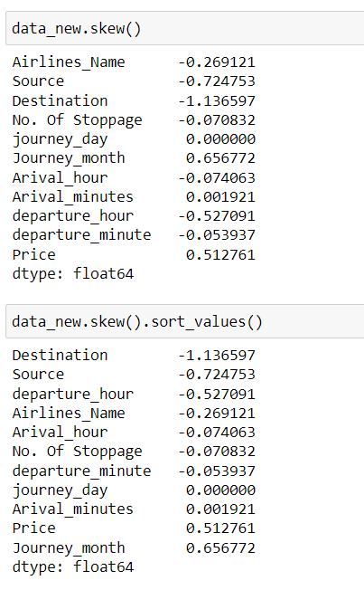
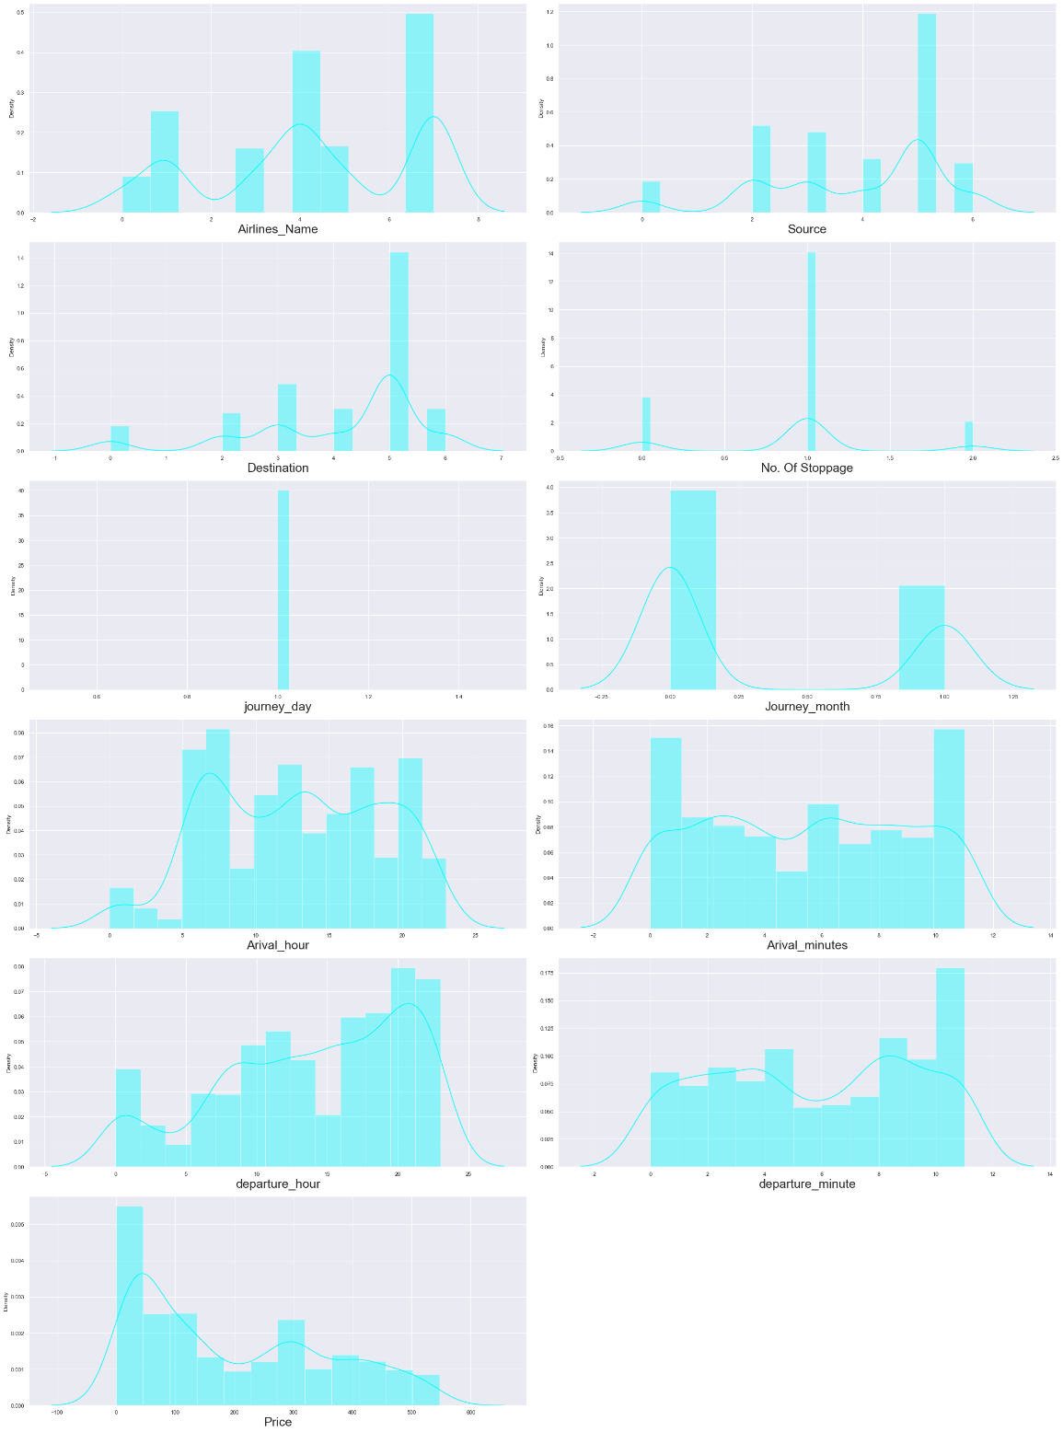
Checking the skewness:
Here we can see that most of the columns are either left skewed or right skewed and only few are somewhat distributed normally and so we have treated the skewness of the columns
Here we can see that the columns with high skewness is "Destination" and the column with less skewness is "journey_day" which has no skewness at all.

Slide 22
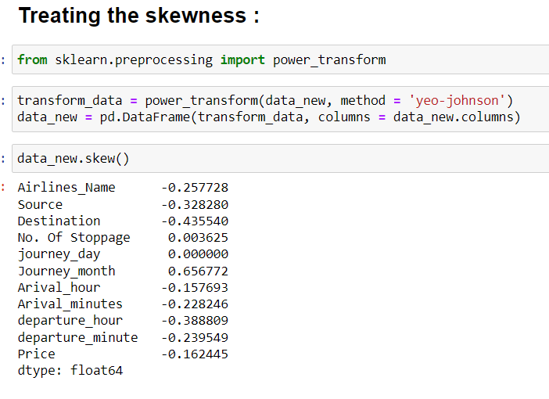
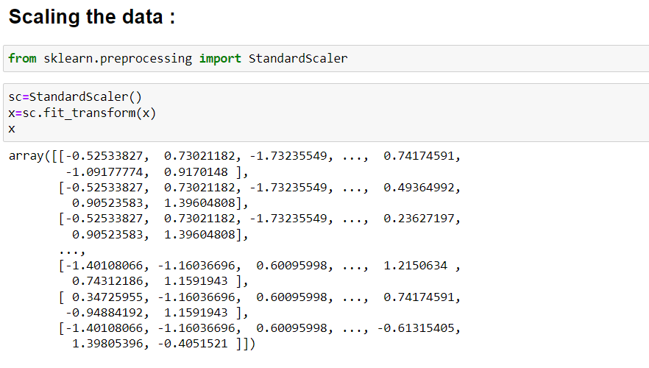
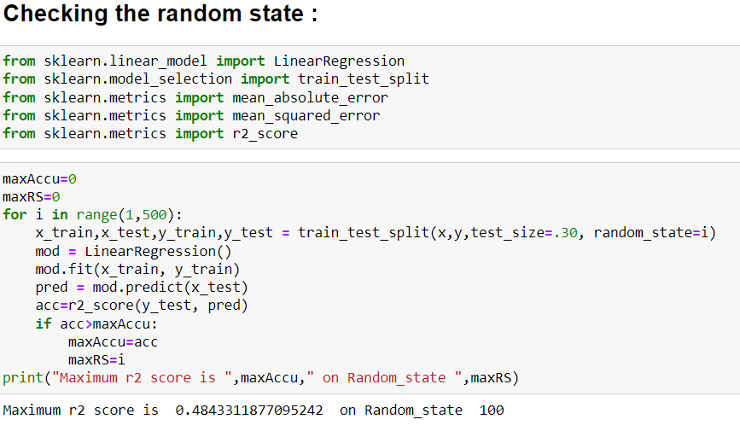
Here we have scaled the data with the help of standard scaler and for the further model building this scaled data is used.
Here we have "power transform" method for treating the skewness and we can see that we have reduced the skewness of the columns
Here we can see that we used train_test_split for separating the data into training data and testing data and we used 70% of the training data for testing 30% of the data and we got r2 score is 48% and Random_state is 100.

Slide 23
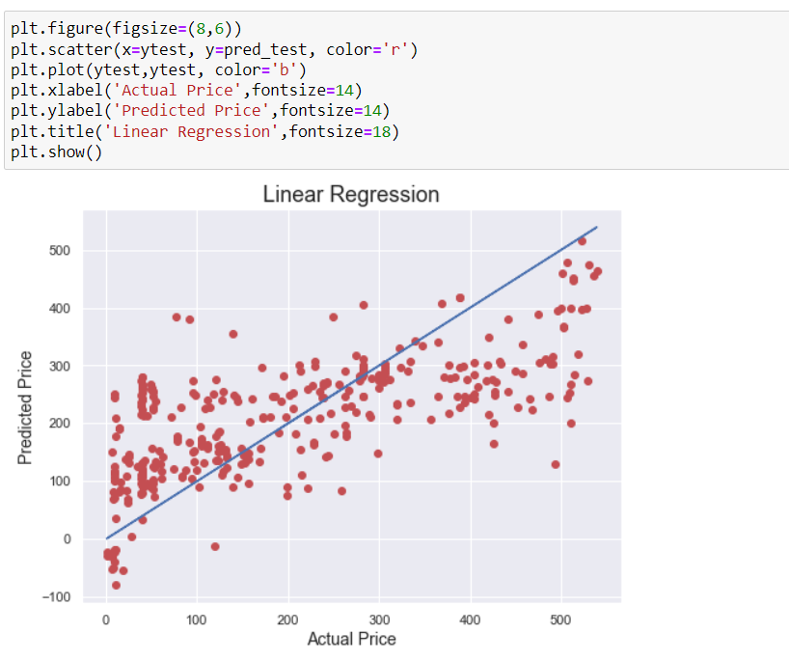
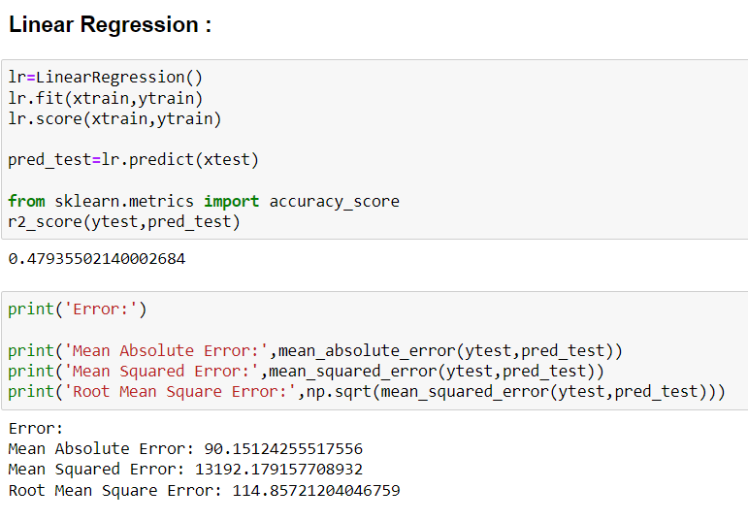
Run and evaluate selected models:
Here we can see that the accuracy score is 47.9% and also we have plotted a graph between "Actual Price" and "Predicted Price" and the graph looks linear.

Slide 24
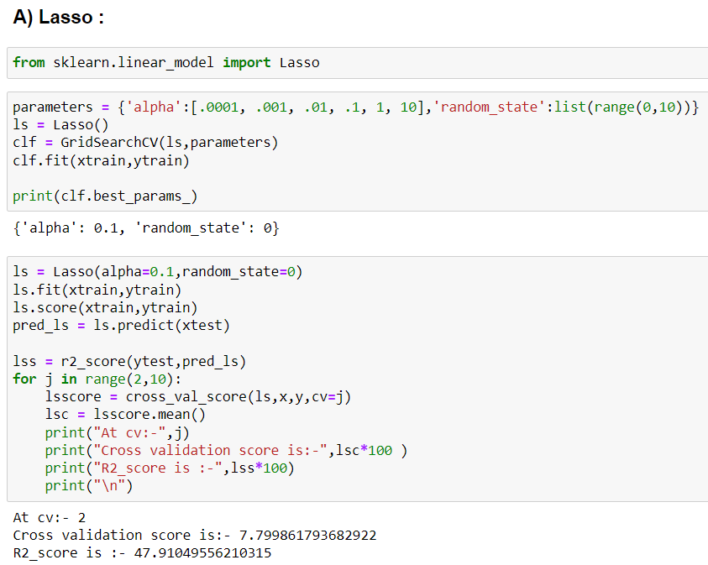
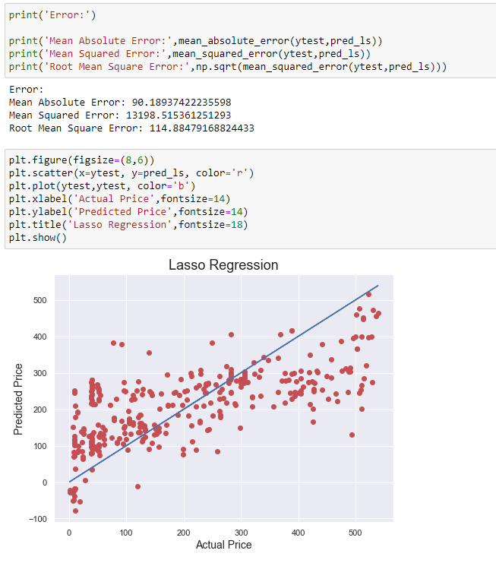


Here we have used regularisation method "Lasso" which gives the best parameters ('alpha': 0.1, 'random_state': 0 and also we got less CV Score and the graph looks linear.

Slide 25



Here we can see that we have used regularisation method "Ridge" which gives the best parameters ('alpha': 0.01, 'copy_X': True, 'fit_intercept': True, 'normalize': True, 'random_state': 0, 'tol': 0.001) and the R2 Score is 47% and the plotted graph between "Actual Price" and "Predicted Price" looks linear.
Here we have used "Gradient Boosting Regressor" which gives the best parameters ('criterion': 'mse', 'loss': 'huber', 'n_estimators': 200) and the R2 Score is 72% with linear plotted graph between the "Actual Price" and "Predicted Price"

Slide 26



Here we can see that we have used "Random Forest regressor" which gives the best parameters as ('criterion': 'mae', 'max_features': 'auto', 'n_estimators': 100) and which gives the R2 Score as 75% and the plotted graph between Actual and Predicted price looks linear.

Slide 27


Here we can see that we have "Decision Tree Regressor" which gives the best parameters as ('criterion': 'mae', 'max_features': 'auto', 'splitter': 'best') and the R2 Score score is 43.9% and the graph plotted between "Actual Price" and "Predicted Price" looks linear.

Slide 28


Here we can see that we have used "Support Vector Regressor" with the best parameters of ('cache_size': 50, 'gamma': 'auto', 'kernel': 'linear') and the R2 Score is of 47% and also the graph plotted between the Actual Price and Predicted Price looks linear.

Slide 29



Here we can see that among all the models used the highest accuracy score is for the model "Random Forest regression" with an accuracy of 75%.

Slide 30


Here we can see that we have made a dataframe for Original and Predicted values.
Saving the model:
The best model is Random Forest Regressor with an accuracy score of 75%
Here we have saved our model.

Slide 31
Limitations of this work and Scope for Future Work:
Due to unrealistic flight prices in the website, the error might be higher for certain regions and duration of flight.
Due to this there might be good amount of difference than expected in the future prediction in a new dataset.
Other than these above limitations, I couldn’t find more scope for improvement

Slide 32


